Slide 1
Understanding the Role of
Post-Secondary Coaches in High Schools
Lynne Haeffele, Ph.D.
Center for the Study of Education Policy
Illinois State University
College Changes Everything Conference
July 2015

Slide 2

The General Problem:
College Readiness
Our global economy demands higher skills
College is becoming a universal need
College preparation is essential:
  Academic, social, logistical, financial
72% of students expect a baccalaureate degree or higher, BUT
  Less than half take appropriate college prep courses
  Less than 2/3 get customized college advisement from school personnel or parents

Slide 3
Knowing How to Go
Academic Preparation
Family Knowledge and Support
Peer Knowledge and Support
School Personnel Knowledge and Support
Financial Preparation
Process Logistics

Slide 4
What about High School Counselors?
National student-to-counselor ratio is 475:1
In some states, the ratio is 900+:1
Counselor focus is mostly academic (scheduling, course-taking) and interventions (individual student problems)

Slide 5

The Specific Problem: Understanding the Role of Post-Secondary Coaches in High Schools
A relatively new and rare role
Operate outside of traditional teaching and guidance counseling
Specifically work to improve students’ college readiness
….How do they “put the pieces together” for students?

Slide 6

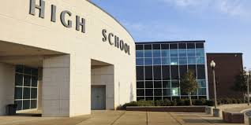


Research Basis:
College Readiness
Four units of analysis:
Student
School
Education System
Society

Slide 7


Level 1: Students
Predictors of College Readiness and College Attainment
Academic Factors
■ Course taking, course rigor, GPA, test scores
Social Factors
■ Family influence
■ Peer influence
■ Engagement, motivation, social connections

Slide 8

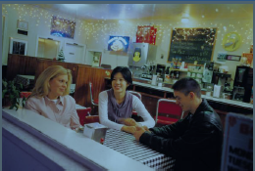
Level 2: Schools
Academic Factors
Curriculum & Assessment
College prep policies
Tutoring
Teacher Training
Social Factors
Personalization
Access to college information
Guidance/Advisement
Parental Involvement

Slide 9
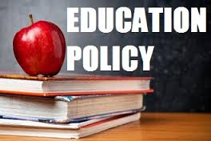
Level 3: The Education System
General lack of empirical research about system effects
Mostly policy reports and a few case studies
Policy recommendations include:
  Articulation between HS and college curriculum
  Opportunities for early credit (e.g. dual enrollment, AP, IB)
  We know the P-12 and higher education sectors are not fully aligned and transitions are not always smooth.

Slide 10
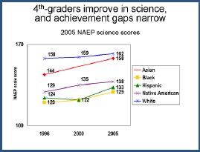
Level 4: Society
Socioeconomic Class
75% of children from families earning >$80K complete a baccalaureate degree; 9% of children from families earning <$25K complete the degree
Race
Gender
Conclusion: Most K-12 schools and higher education institutions reproduce society’s inequities

Slide 11

So who is to blame if students aren’t ready?
Everyone and no one!
It’s difficult to “fix” all four levels at once; they are hard to control
Is there another way to tackle the readiness problem?

Slide 12




Operating Factors:
Things we can control
Structures
Actions
Relationships
Resources

Slide 13
What if schools could mobilize
all four factors
to get students and families
the academic, social
and financial support they need for college?
STRUCTURES
RELATIONSHIPS
ACTIONS
RESOURCES

Slide 14
Study of Post-Secondary Coaches in High Schools (2007-2009)
One working in a GEAR-UP high school with over 70% low income students
One working in a traditional high school with fewer than 30% low income students
Used social capital theory as an analytical frame
“By making connections with one another and keeping them going over time, people are able to work together to achieve things that they either could not achieve by themselves or could only achieve with great difficulty.” Field (2003)

Slide 15
Research Questions
Where do post-secondary coaches fit within school structures and processes?
What activities (actions) and relationships do the coaches engage?
What resources do coaches access, mobilize and/or confer for students and others?

Slide 16
Data collection and analysis
Comparative case study between the two coaches and schools
Interviews, document and website analysis, field observations, artifacts
Coding materials to find natural categories and themes
Coding materials based on social capital components: structures, actions, relationships, resources
Comparison between coding methods and cases

Slide 17
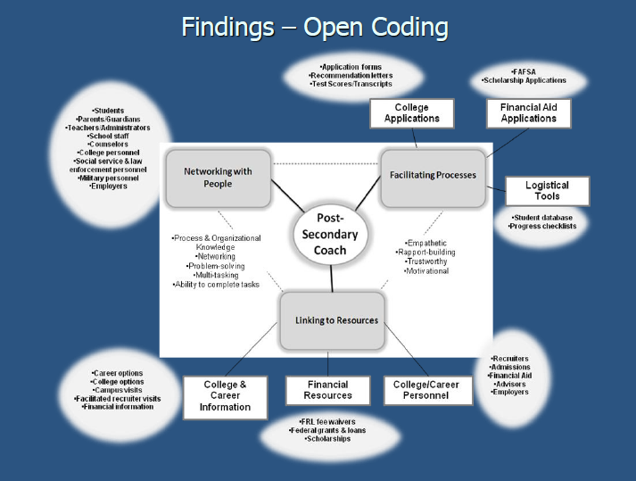

Slide 18
Findings: Social Capital Analysis
(1)Structural positioning matters: a permanent, full-time and board-sanctioned salaried position in a flexible, non-bureaucratic school produces more resources for more students
(2)Extensive network ties for a coach in a central network location, including both strong (internal) and weak (external) ties, providing access to more resources for students. External ties include college admissions officers, financial aid officers, and recruiters.
(3) A wider variety of instrumental actions on the part of the coach will benefit a larger number of students. These include facilitated recruiter visits, financial aid assistance for parents, and individual interventions.

Slide 19
Bottom Line Results
College enrollment trends in low-income high school with full-time required coaching for all students

Slide 20
Who can coach?
Current staff with specific coaching assignments
One guidance counselor “repurposed” for college coaching
Retired teachers and counselors
Community members
Retired higher education personnel
Family or other volunteers
All would require specific training on coaching role

Slide 21
Parting Thought:
Clearinghouse vs Brokering
A “clearinghouse” high school makes college-going and other post-secondary resources available, but students must know how to access them on their own
A “brokering” high school takes a proactive role in making sure that it links every student with a post-secondary plan and the resources to achieve it
Guess which type helps more students?

Slide 22
Lynne Haeffele, Ph.D.
Center for the Study of Education Policy
College of Education
Illinois State University
lmhaeff@ilstu.edu

